Slide 1

Predicting House Prices in Pakistan
Sami Munir
CS105 | Final project update

Slide 2

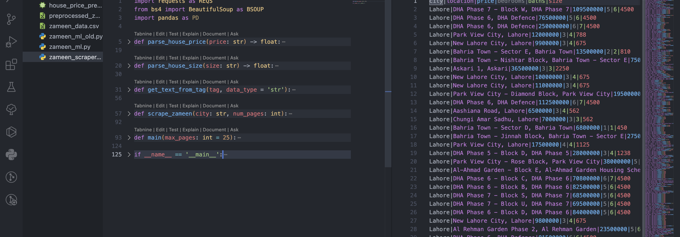
Background
Rationale: utilize computer programming and automation to predict house prices in Pakistan.
Solution:
Web scraping
Building machine learning models to later predict house prices based on x number of features.

Slide 3
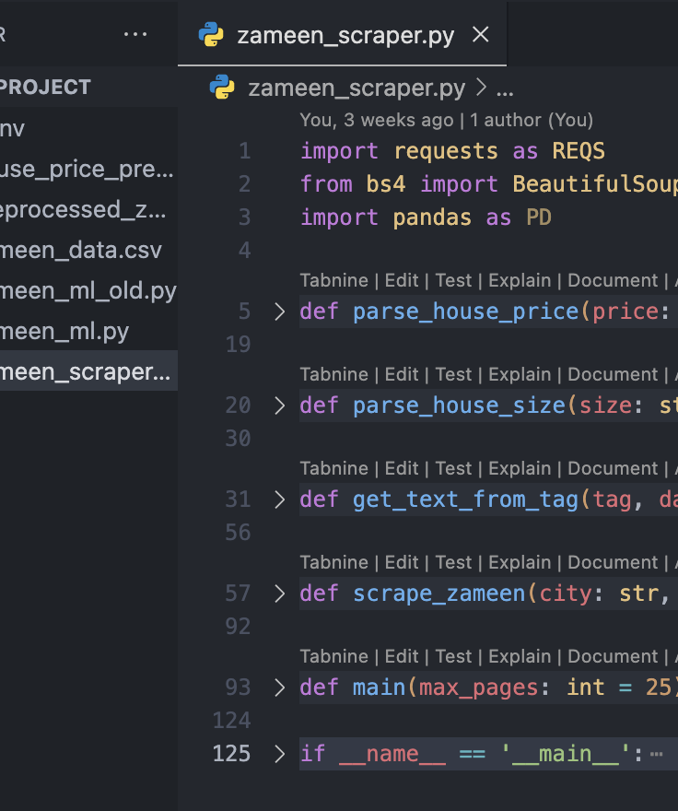
Intermediary Challenges While Implementation
Finding organized and satisfactory data to train the machine learning model(s).
Needed a way to collect substantial (updated) data and store it in an organized (table-like) manner.
Web scraping highlighted inconsistencies in data values and units of quantitative measure.
Non-standard units had to be converted and specifically handled while parsing.

Slide 4

Solution
Web scrape zameen.com (Pakistan National Real-Estate webapp)
Dynamic collection of data (automated)
Updated/recent data available
Dynamically store data in tabular format (.csv).
Use collected data to implement machine learning models (training phase)
Data preprocessing & feature engineering
Data insights
Implementing/testing various ML models
Use best (most-fit) model to predict new/unknown house prices based on features.

Slide 5
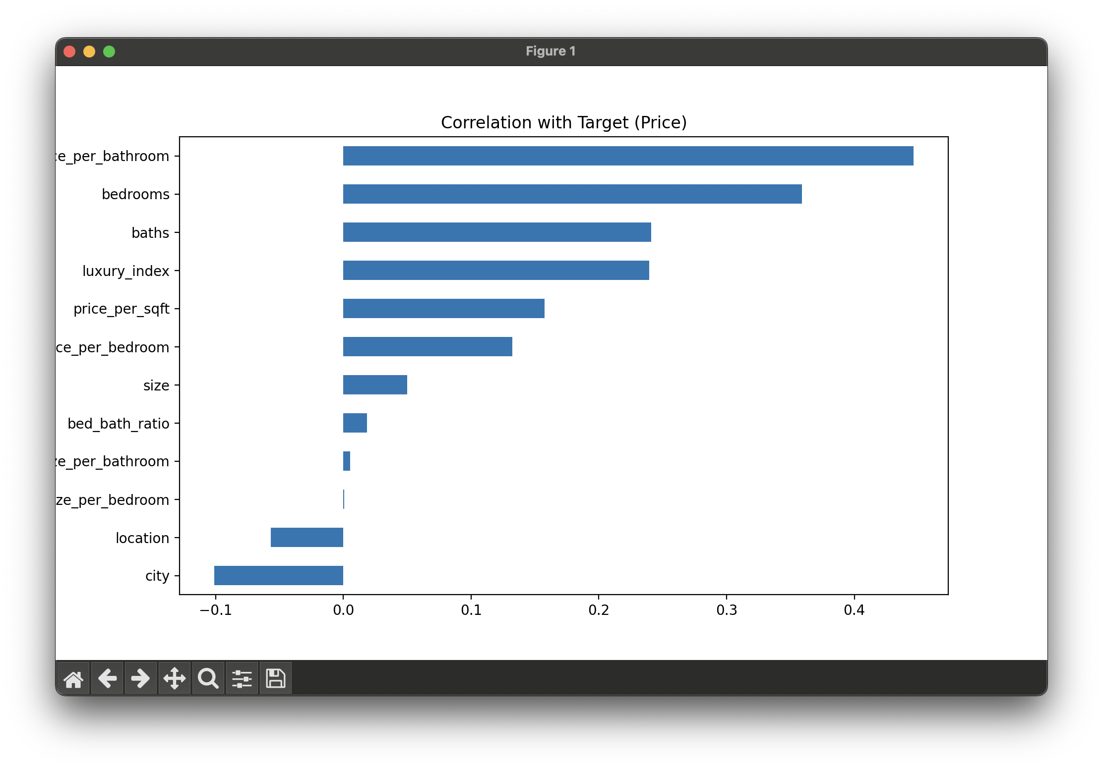
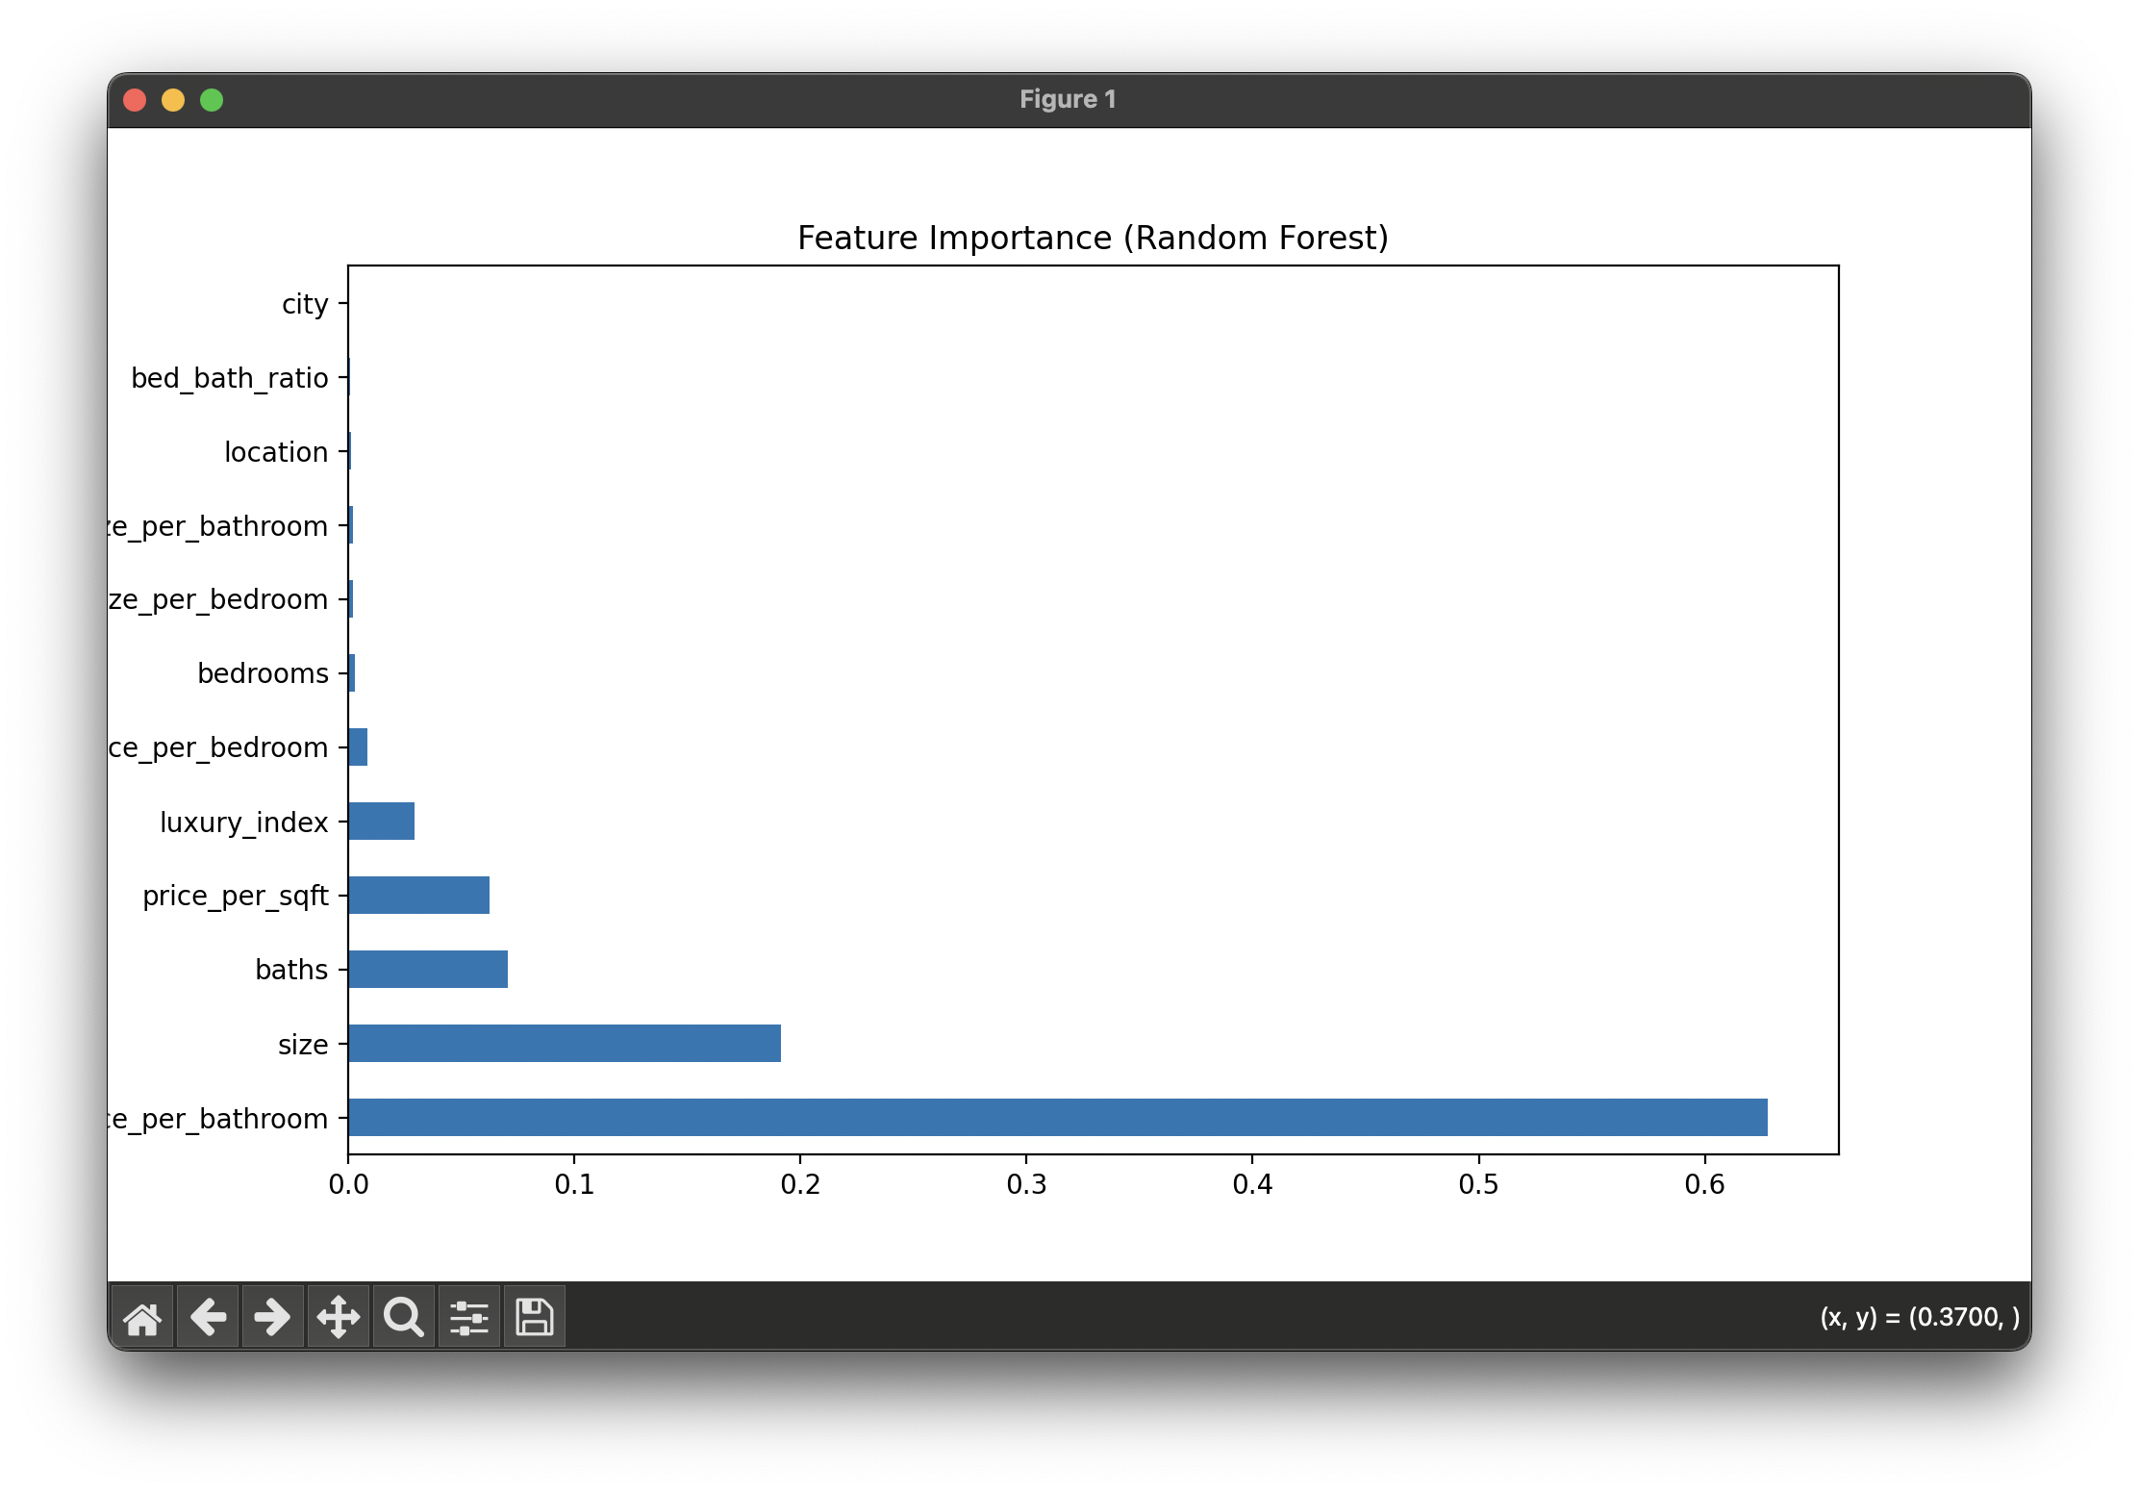
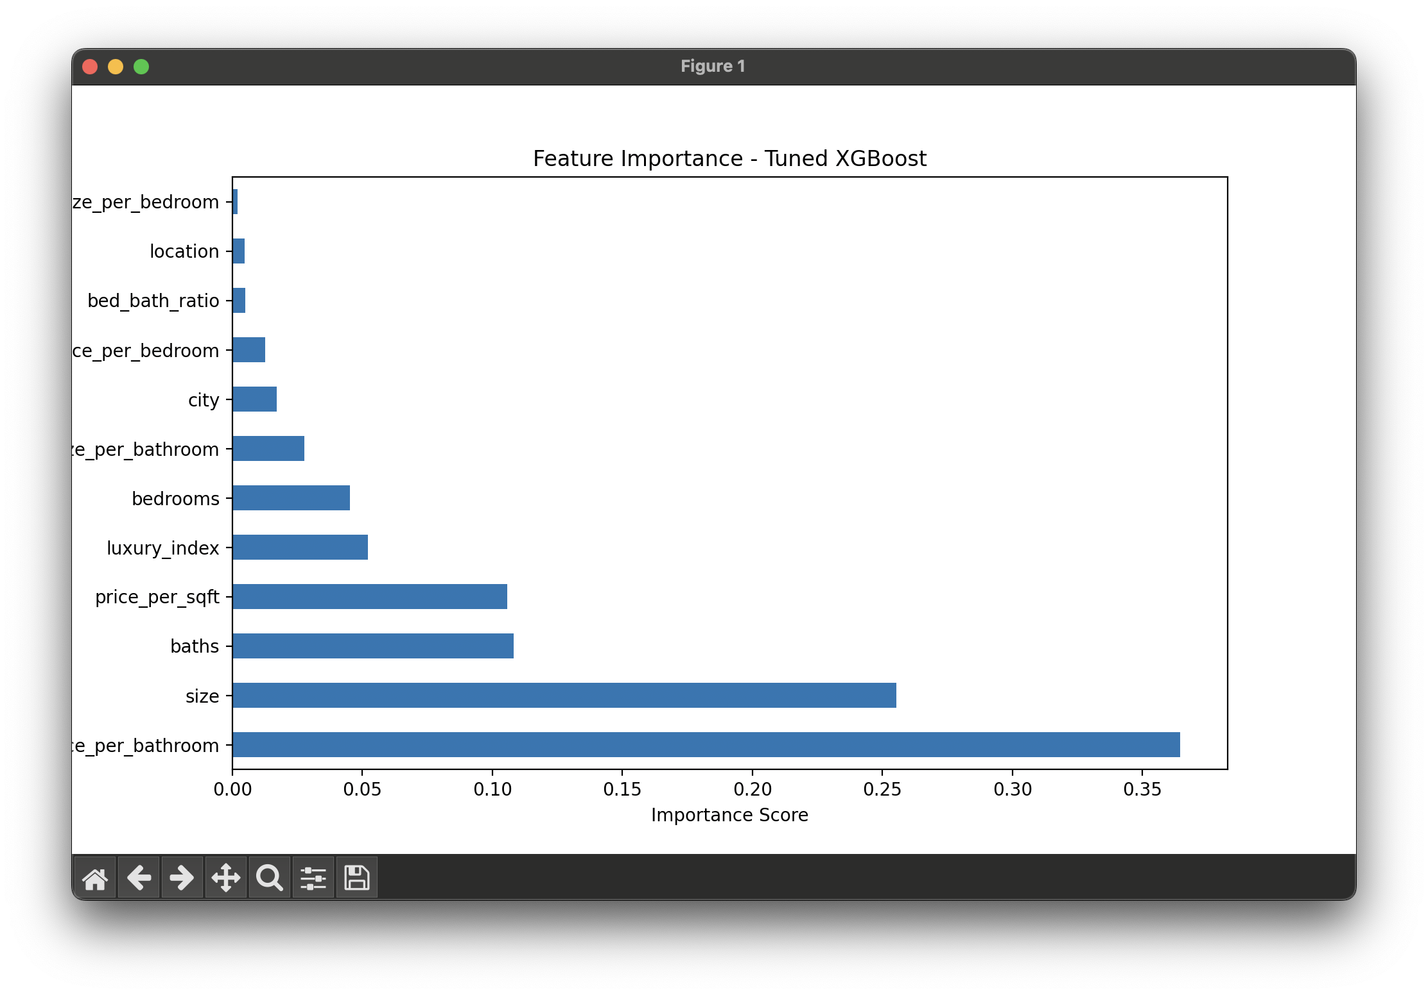
Insights (I)
Feature Correlation
Feature Importance (I)
Feature Importance (II)

Slide 6
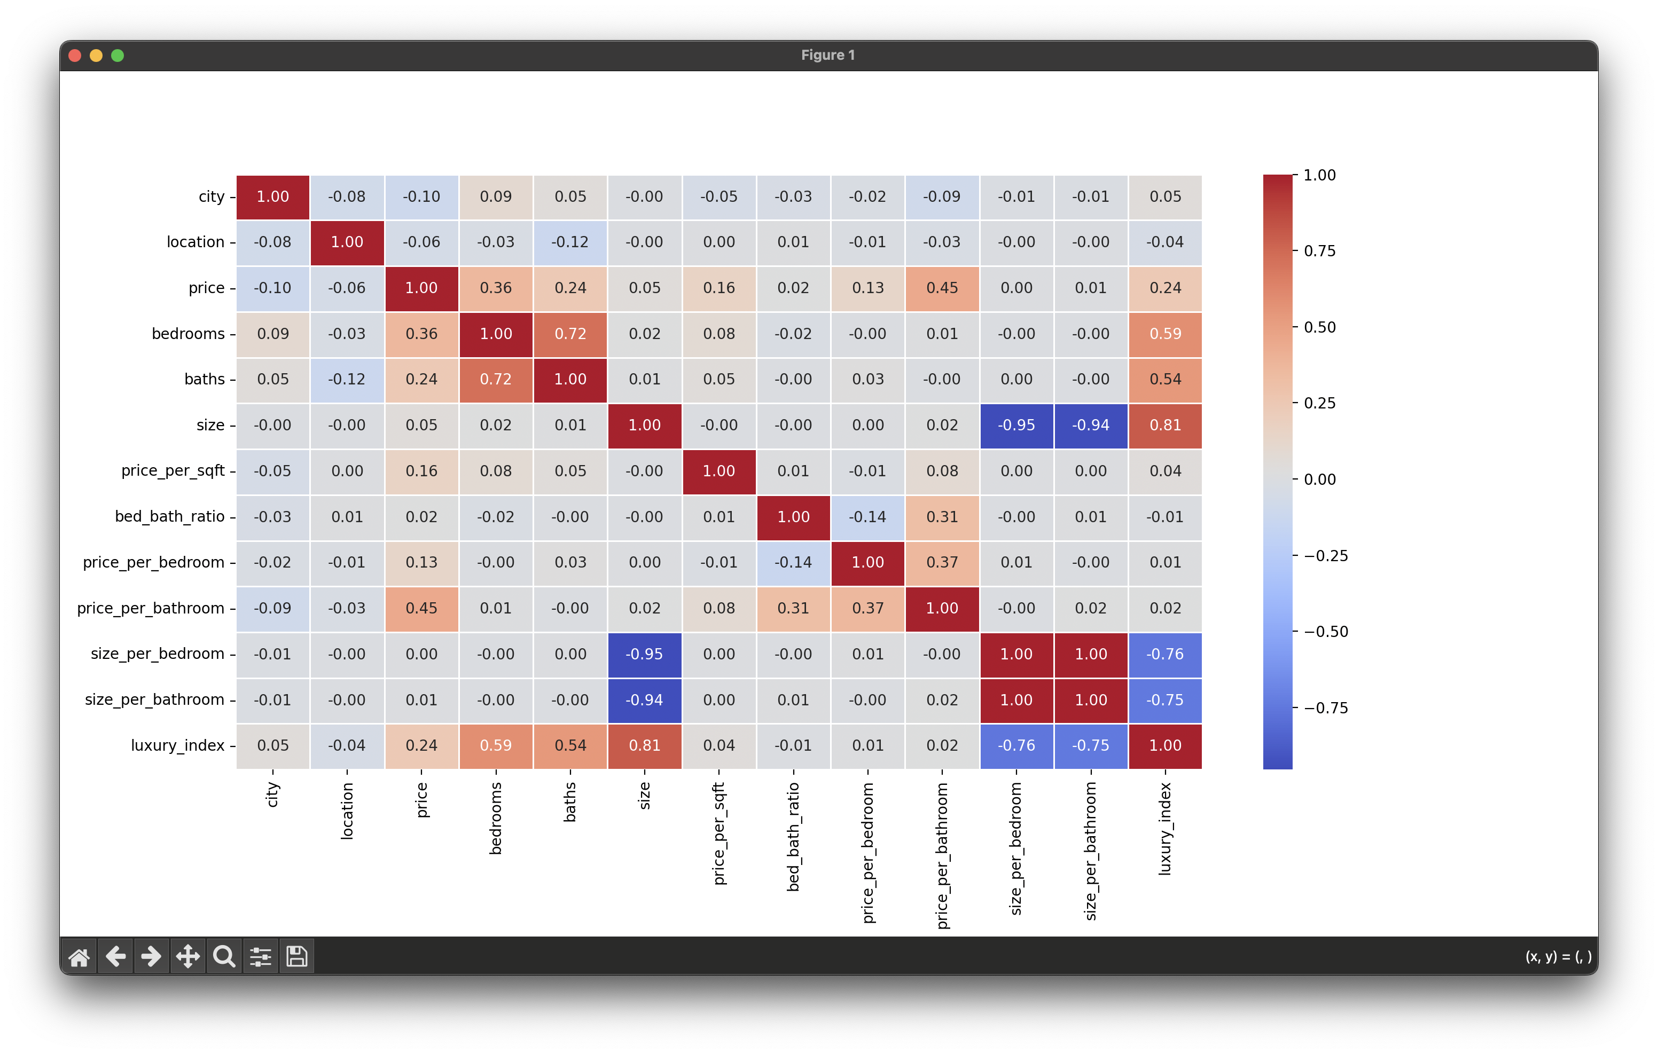

Slide 7
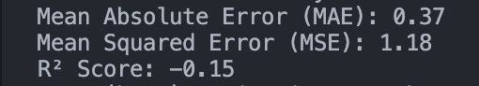
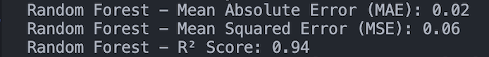
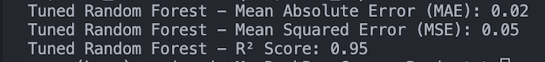
Insights (II)
Linear Regression
Random Forest Regressor
Tuned Random Forest Regressor

Slide 8
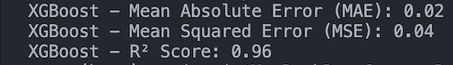
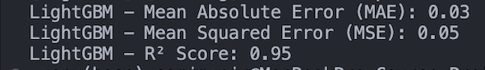
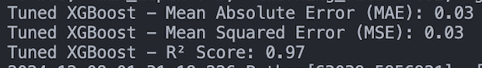
Insights (III)
XGBoost
LightGBM
Tuned XGBoost

Slide 9
Data Analysis & Considerations
While considering the lack of details in the researched data, the probable human intelligible analysis leads us to understand that most metropolitan-based cities are much more expensive to live in and more rural areas are less expensive. These discoveries were evident when deep data analysis was performed on different metrics like the maximum and minimum price of houses per city. With the necessary human agent, it is important to realize that cities like Lahore, Karachi, and Islamabad have the highest average prices compared to rural and deserted areas/cities like Peshawar, Gujranwala, and Attock.

Slide 10
Data Analysis & Considerations Continued
Another interesting human intelligible perception that is not available directly in the researched data indicates that areas which are coastal or located in mountainous terrain are relatively much more expensive to live in! This compares distinctly with houses inland. This could suggest environmental or geographical disadvantages that would require house prices to be much more expensive compared to those inland.

Slide 11
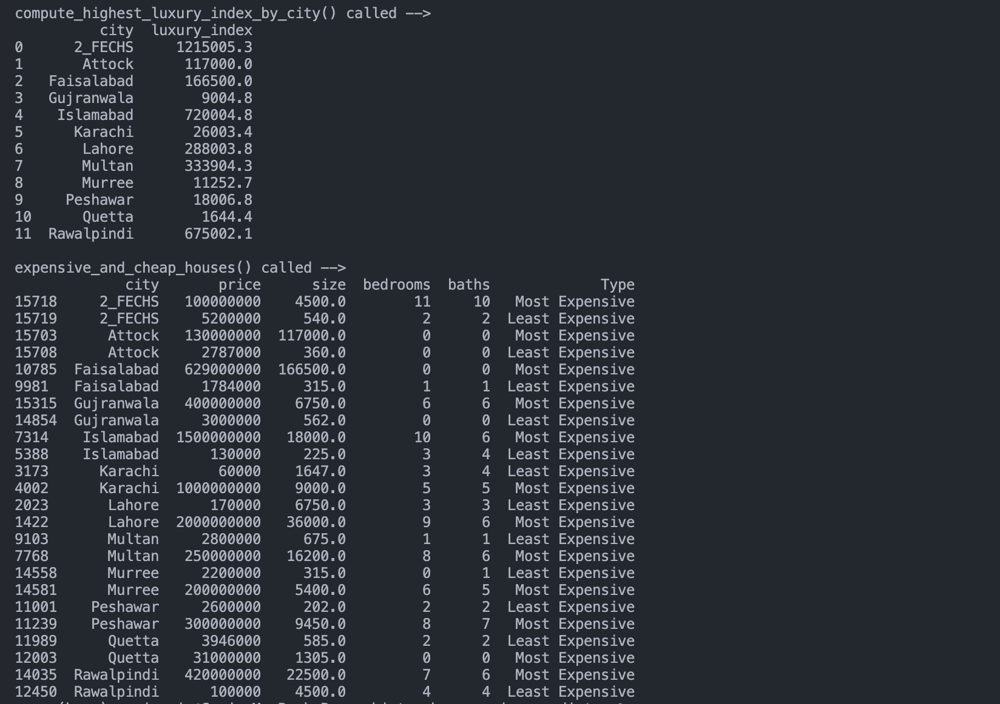
Human Agent Interpretation
This data highlights how a human agent is necessary to extrapolate and make more intuitive analyses rather than those presently available on the surface from the research.

